Slide 1
Smart & Secure Online Exams
Innovating online assessments with a secure and analytical approach to enhance the exam experience for students, teachers, and parents.

Slide 2
Cheating remains rampant in online exams, compromising academic integrity and fairness.
01
Problem Statement
The lack of analytics prevents educators and parents from understanding student performance and improving exams.
02
Key issues affecting online exam integrity and effectiveness today.
Additionally, weak security measures expose sensitive data and enable unauthorized access.
03

Slide 3
Proposed Solution
A comprehensive platform that ensures integrity and insightful analytics for online exams
AI + Human Hybrid Proctoring: Use AI for live monitoring (face detection, eye movement, multiple person detection) + teacher intervention if needed.
Our Smart & Secure Online Exam System will provide robust security measures and analytics to enhance user experience and ensure the integrity of assessments in the digital learning environment.

Slide 4
Fully Function and Secured Admin section
Centralized control to manage exams, users, and analysis results with security.
Secure ExamSystem
Key Security features
Offers authentication, smart exams, security with tab switching detection and webcame support and get instant result with correct answers ,
Guardian Insight Panel
IAllows parents to securely view their child’s results, track progress, and analyze performance through graphs

Slide 5
01
Students initiate the exam through a secure platform, ensuring integrity.
Workflow Overview
Evaluation occurs automatically, providing instant feedback for students and teachers.
02
Streamlined process from student and teacher engagement to detailed analysis
Results are accessible for parents and teachers, facilitating informed discussions on performance.
03

Slide 6
Innovative Features
Enhancing Online Exam Integrity and Monitoring Capabilities
Parents get performance + behavior report (focus time, attention level, weak areas)
Teachers get class-wide analytics (average score, time taken per question, difficulty heatmap)
Our system incorporates strong authentication methods and real-time violation tracking to ensure exam integrity, paired with intuitive dashboards for monitoring, providing a seamless experience for students and educator and provide the parent experience with the analysis

Slide 7
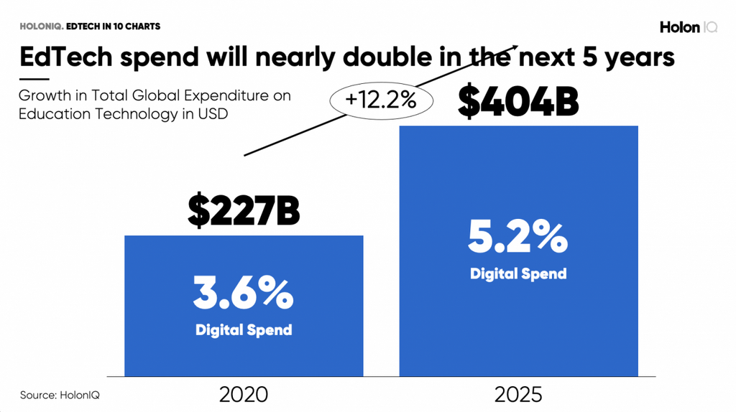
Market Opportunities in EdTech
The EdTech sector is rapidly expanding, highlighting the need for secure assessment solutions.

Slide 8
Students
Improved integrity leads to fairer assessments and better learning outcomes for all.
Benefits and Impact of Our Solution
Teachers
Enhanced analytics provide valuable insights into student performance and exam results.
Parents
Monitoring progress allows active involvement in their child's educational journey.

Slide 9
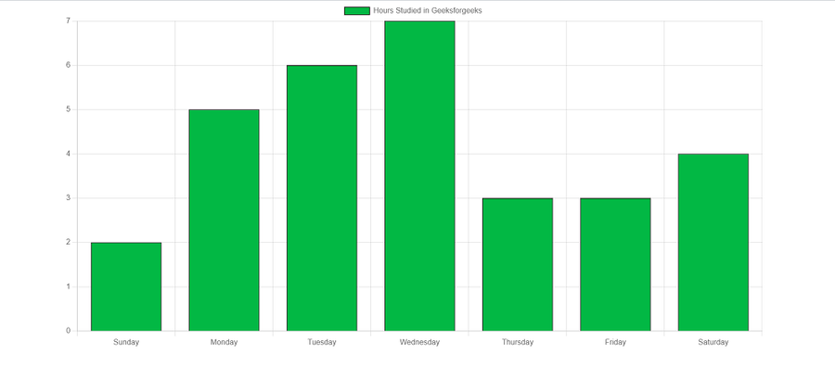
Dashboard and Results
An intuitive interface showcasing exam performance and analytics for stakeholders
Our user-friendly dashboard provides real-time insights into student performance, allowing teachers and parents to track progress and identify areas for improvement efficiently.

Slide 10
If the internet disconnects, the exam continues without interruption by saving answers in browser storage. Once the connection restores, the server updates automatically.
01
Future Scope
Integrate the Question bank for the Teachers easibility with question level integration
02
Exploring advancements in AI and adaptive learning for education.
Enhanced analytics provide insights into performance trends, improving teaching strategies and outcomes.
03

Slide 11
Clever Codex
Team Members:
Tausif Khan: Team Leader Backend and Frontend
Sourabh Chandrakar: Backend
Divyanshu Sahu: UI/UX and Research

